Slide 1
Version Control and GitHub
Warren Frame

Slide 2


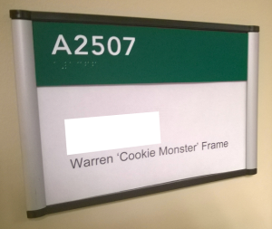


About Me
What do I do?
Infrastructure Engineer, FAS Research Computing, Harvard University
Design and build solutions, learn, share
Other interests:
science, infosec
tech, cooking
tennis, family
Where to find me
Twitter.com/PSCookieMonster
LinkedIn.com/in/wframe
RamblingCookieMonster.github.io
Github.com/RamblingCookieMonster
PowerShell Slack Community
Notes:
Microsoft, VMware, Citrix, etc.
I'm on LinkedIn and Twitter, feel free to connect
Slack - Modern hosted chat service, it's bridged with the PowerShell channel on IRC and is quite handy:
I can ask questions and talented folks like Joel Bennet, Dave Wyatt, Kirk Munro, Justin Rich, and many others, including a few from the PowerShell team, might jump in to help.
I also find that trying to help others can help you learn a bit.
If your boss is asking 'why are you in a chatroom at work!' - turns out when you put a bunch of PowerShell folks in a chat room, some interesting ideas that you could take back to work and implement might come up. Or someone mentions an issue you're experiencing and how they fixed it. Very helpful!
slack.poshcode.org > submit your e-mail, join up!
Some fun Git-related posts:
Source Control Survey Results - http://ramblingcookiemonster.github.io/Source-Control-Survey/
GitHub for PowerShell Projects - http://ramblingcookiemonster.github.io/GitHub-For-PowerShell-Projects/
Fun with GitHub, Pester, and AppVeyor - http://ramblingcookiemonster.github.io/GitHub-Pester-AppVeyor/
GitHub, Pester, and AppVeyor: Part Two - http://ramblingcookiemonster.github.io/Github-Pester-AppVeyor-Part-2/
Testing DSC Configurations with Pester and AppVeyor - http://ramblingcookiemonster.github.io/Testing-DSC-with-Pester-and-AppVeyor/
A topic we won’t cover here, but GitHub pages are a great way to host your blog content, if you don’t mind a little yak shaving: http://ramblingcookiemonster.github.io/GitHub-Pages/

Slide 3

Goals
Use version control for your own projects
Foundation to contribute to projects on GitHub
Background to make a case to bring version control to your team at $Work
Become a Git Pro!
Notes:
User Version Control for your own projects…
Whether at home or at work
In case you missed it, Microsoft open sourced PowerShell, DSC resources, and other PowerShell related tools
https://github.com/PowerShell

Slide 4
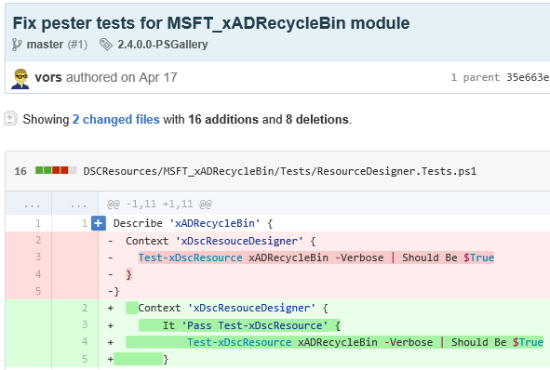
What is Version Control?
System to manage changes to files
Who vors
When April 17
What Files and differential
(Sometimes) Why To fix Pester tests
AKA Revision Control, Source Control
Notes:
Picture of a commit from the DSC resources on GitHub – a commit is just a snapshot of the project at one point in time
I’m going to make the assumption that you’ve seen the light and want to use version control, I don’t want to spend too much time on the importance of using this. I’ve included a few links in the notes. Long story short? It’s included in Tom Limoncelli’s Operations Report Card.
Plenty of examples on why you should use source control:
http://www.opsreportcard.com/section/6 – Because Tom said so : )
http://stackoverflow.com/questions/1408450/why-should-i-use-version-control
http://www.git-tower.com/learn/git/ebook/mac/basics/why-use-version-control
http://hgbook.red-bean.com/read/how-did-we-get-here.html
http://betterexplained.com/articles/a-visual-guide-to-version-control/
Not going into details, at work, we have a module used by a few teams.
When I push to this git repository, Jenkins can run some pester tests, and if all goes well, copy the module out to a network share that systems regularly update from.
Examples leveraging a popular continuous integration and delivery solution, Jenkins:
https://www.hodgkins.net.au/powershell/automating-with-jenkins-and-powershell-on-windows-part-1/ (Link to part 2 included)
http://www.dexterposh.com/2015/06/powershell-pester-jenkins-ci.html
Examples using GitHub:
http://ramblingcookiemonster.github.io/GitHub-For-PowerShell-Projects/#continuous-integration
http://powershell.org/wp/community-build-server/ - Thanks to Dave Wyatt, PowerShell.org, Chef, and anyone else behind this!

Slide 5
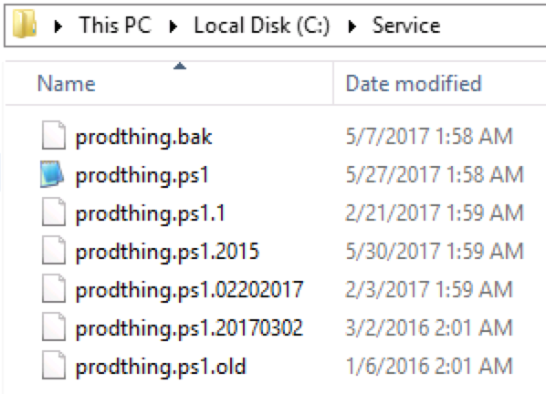
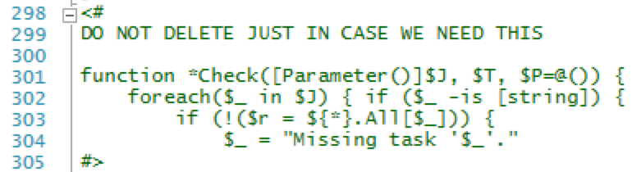

Why Version Control?
Notes:
Which is the real script?
Are people changing old scripts by accident?
What on earth do I do when I need to change the running script? Append a creative new time format? Give up?

Slide 6
Why Version Control?
Revert to or review any change
Maintain previous versions
Maintain multiple versions (e.g. experimental features)
Compare differences
Share and collaborate
Modern solutions might assume you have it!
Configuration management
Infrastructure-as-code
Continuous Integration and Deployment
Notes:
I’m going to make the assumption that you’ve seen the light and want to use version control, I don’t want to spend too much time on the importance of using this. I’ve included a few links in the notes. Long story short? It’s included in Tom Limoncelli’s Operations Report Card.
Plenty of examples on why you should use source control:
http://www.opsreportcard.com/section/6 – Because Tom said so : )
http://stackoverflow.com/questions/1408450/why-should-i-use-version-control
http://www.git-tower.com/learn/git/ebook/mac/basics/why-use-version-control
http://hgbook.red-bean.com/read/how-did-we-get-here.html
http://betterexplained.com/articles/a-visual-guide-to-version-control/
Not going into details, at work, we have a module used by a few teams.
When I push to this git repository, Jenkins can run some pester tests, and if all goes well, copy the module out to a network share that systems regularly update from.
Examples leveraging a popular continuous integration and delivery solution, Jenkins:
https://www.hodgkins.net.au/powershell/automating-with-jenkins-and-powershell-on-windows-part-1/ (Link to part 2 included)
http://www.dexterposh.com/2015/06/powershell-pester-jenkins-ci.html
Examples using GitHub:
http://ramblingcookiemonster.github.io/GitHub-For-PowerShell-Projects/#continuous-integration
http://powershell.org/wp/community-build-server/ - Thanks to Dave Wyatt, PowerShell.org, Chef, and anyone else behind this!

Slide 7
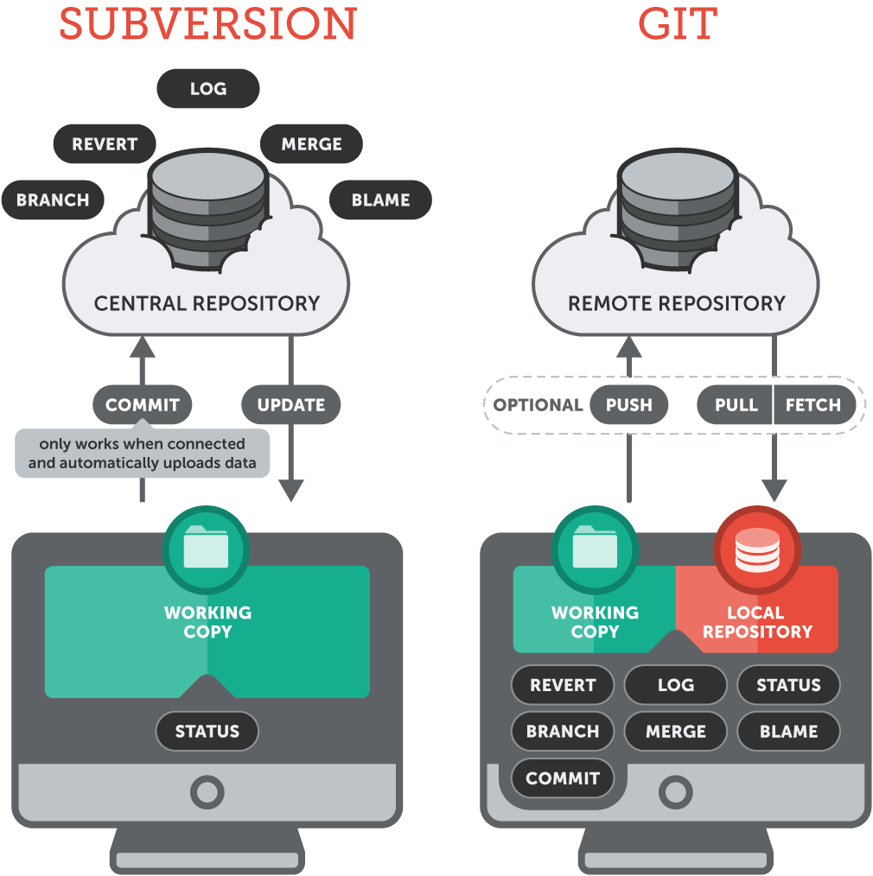
What Version Control System Should I Use?
Centralized (Ignore these)
Work directly against a central server
Subversion, CVS, Perforce, etc.
Distributed
Work locally, ideally push to remote repo
Git, Mercurial (Hg), etc.
New? Just pick Git. Maturity, tooling, references
SaaS solutions
GitHub, GitLab, BitBucket, VSTS, +
Self-hosted solutions
GitLab, GitHub Enterprise, BitBucket Server, TFS, +
git-tower.com
Notes:
Git Google talk from Linus Torvalds https://www.youtube.com/watch?v=4XpnKHJAok8 – discusses some of the design goals for git, and why the centralized model isn’t a great fit - paraphrased, Linus is more explicit : )
Like anything, evaluate what fits your workflow and needs, but IMHO most new deployments likely warrant a distributed VCS
It’s important to note that the processes we’re walking through today could be applied to an on-premise solution like GitLab. There will be small operational differences, but many similarities.

Slide 8
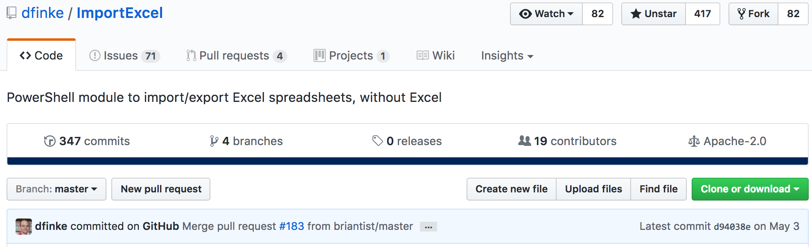
Using and Contributing to Open Source
Less time re-inventing wheels
Benefits from ‘upstream’ contributions
Cleaner, abstracted code
Notes:
ImportExcel
In the past, if you wanted to fix a bug or add a feature to Microsoft’s DSC resources, community modules, etc. you would…
Update the resource in your environment!
Author updates the resource upstream…
You merge in your changes or put off updating
Not sustainable
Now:
Learn the basics of GitHub and Git
Submit a pull request
If accepted, your code will be included in all future updates!

Slide 9
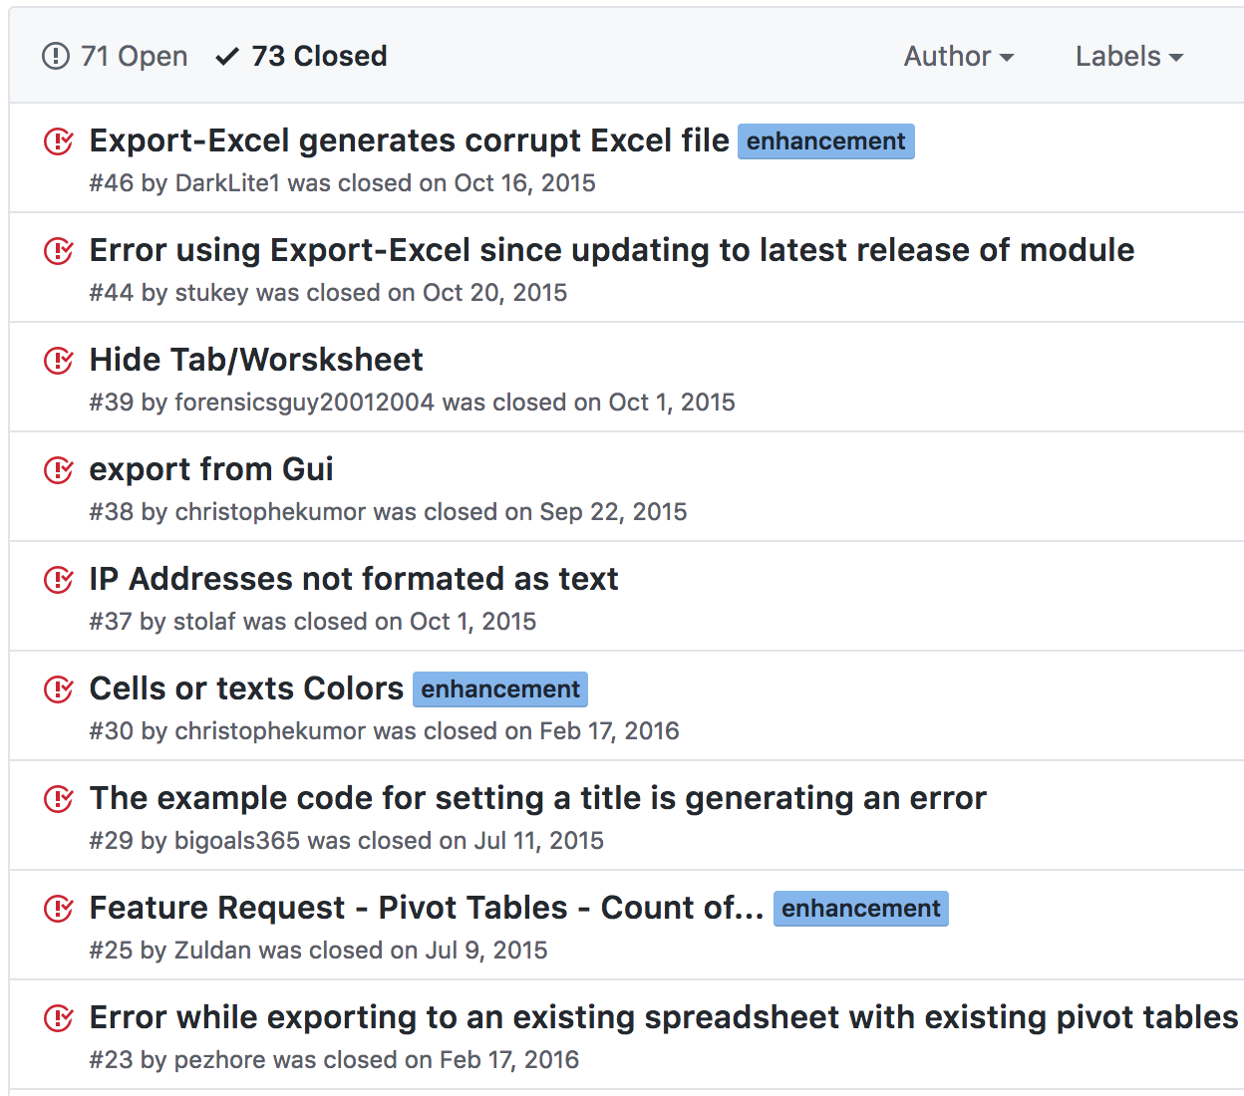
Using and Contributing to Open Source
More ideas
More eyes on the code

Slide 10
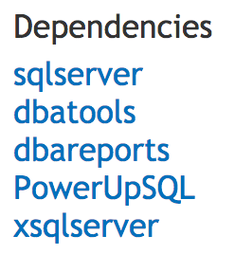
Using and Contributing to Open Source
Building blocks
PoshBot uses...
Configuration, PSSlack
AutomatedLab uses...
PSLog, PSFileTransfer, HostsFile, more
Database is a meta package using…
dbatools, dbareports, sqlserver, PowerUpSQL

Slide 11
Using and Contributing to Open Source
Everyone wins
Maintainers (Owners)
Contributors
Users
Employers
Community as a whole

Slide 12
Barriers to Open Source
Unfamiliar legal / HR folks
Assumptions
FUD
Licensing
I don’t have time
I’m not smart enough
Notes:
Chef webinar for lawyers: https://www.youtube.com/watch?v=xD36i9DFT_Y, https://opensource.guide/legal/
Assumptions / ‘that’s how it’s always been’
FUD: We don’t want people to see code from our environment, they could use it to attack us! Right.
Licensing: Projects that have no license, or GPL, can haunt lawyers

Slide 13

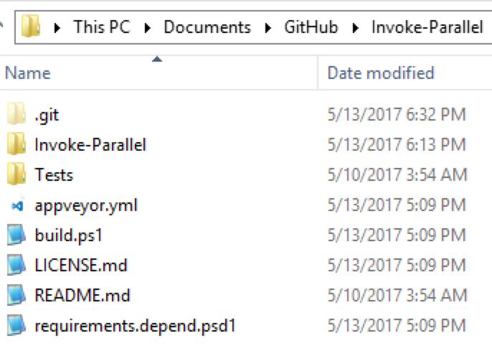
GitHub Workflow – Your Own Project
Origin
1. Clone or Pull
5. Push
2. Save changes
3. Add
4. Commit
[5a]. Pull
Notes:
Assuming you’re just working on the master branch
When working with others, it’s good practice to pull changes from GitHub often, to avoid merge conflicts. A pull fetches and merges into your working folder, so, pull after a commit.
Basically…
Clone once
Make changes
Add+Commit
Push
Make changes
Add+Commit
Push
Push is optional, I tend to do it often in case anything happens on the client, or if I want to work from another client
Repeat

Slide 14


GitHub Workflow – Someone Else’s Project
0. Fork
Upstream
Origin
6. Pull Request
1. Clone or Pull
5. Push
2. Save changes
3. Add
4. Commit
[5a]. Pull
Notes:
Pretty much the same workflow! You just fork (copy) the project ahead of time.

Slide 15

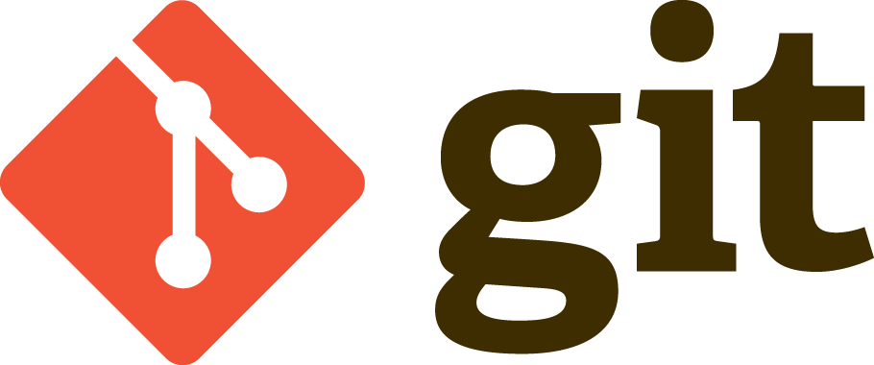
Demo!
Notes:
To show…
Light spelunking

